Slide 1

Project 1
Gender Pay Gap
By Yves Janssens (215C)
This presentation template was created by Slidesgo, including icons by Flaticon, and infographics & images by Freepik.

Slide 2
TABLE OF CONTENTS
01
02
03
Problem Statement / Objective
Data Preparation
Overview
04
05
06
Data Analysis
Limitations &
Caveats
Recommendation on
Data Collection Process

Slide 3
PROBLEM STATEMENT / OBJECTIVE
01

Slide 4
Problem Statement
Objective
Gender pay differences remain a critical issue in the UK workforce, with variations across industries, regions, and individual companies.
While national policies mandate gender pay gap reporting, the extent of differences and their influencing factors remain complex.
This analysis seeks to uncover trends, industry-specific and regional differences, as well as identifying companies with the most significant pay gaps.
The objective of this analysis is to:
 Determine the national average gender pay gap by
analyzing median and mean pay gaps across all
reporting companies.
 Compare pay gaps across industries to identify
sectors with the largest and smallest differences.
 Analyze regional differences in gender pay
differences to determine if certain parts of the UK
show higher gaps.
 Identify companies with the largest pay gaps to
highlight outliers and potential areas for
improvement.

Slide 5
DATA PREPARATION
02

Slide 6
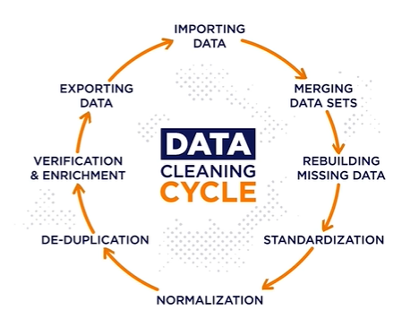
ETL PROCESS
1. Extract
The raw dataset was downloaded from https://gender-pay-gap.service.gov.uk/viewing/download and contained 27 columns with a total of 10,564 companies.
2. Transform
Data Preparation: Duplicates were checked, and no row duplicates were found. Columns that were not relevant for the analysis were removed.
Data Cleaning & Standardization: Missing SIC Codes were filled with “Unknown”. Data was extracted for original columns and additional columns were created to enhance the data analysis.
3. Load
The cleaned data consisting of 24 columns with a total of 10,564 companies was stored and was accessible for querying, analysis, and visualization with Excel.

Slide 7
OVERVIEW
03

Slide 8
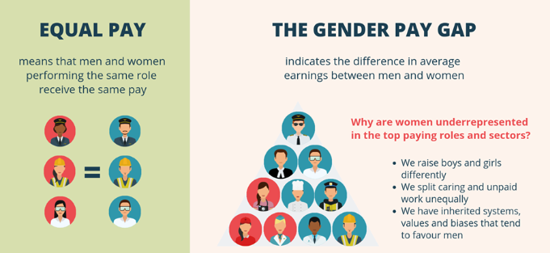
OVERVIEW
The Gender Pay Gap is linked to but is NOT the same as Equal Pay.

Slide 9
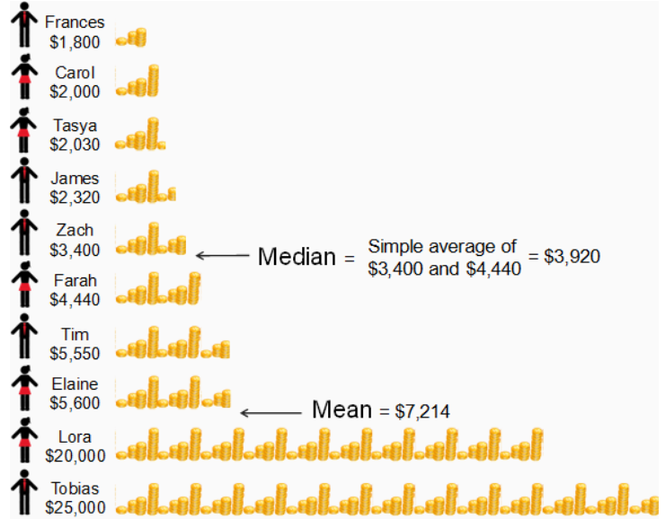
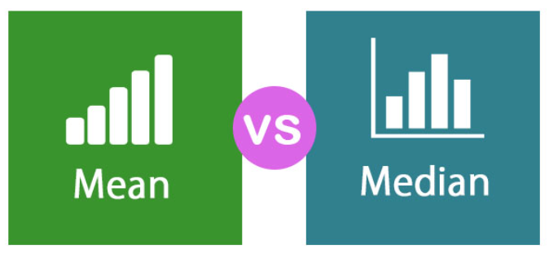
OVERVIEW
To avoid influence of extreme values, median will be used for the analysis of the Gender Pay Gap.
Extreme values
https://stats.mom.gov.sg/

Slide 10
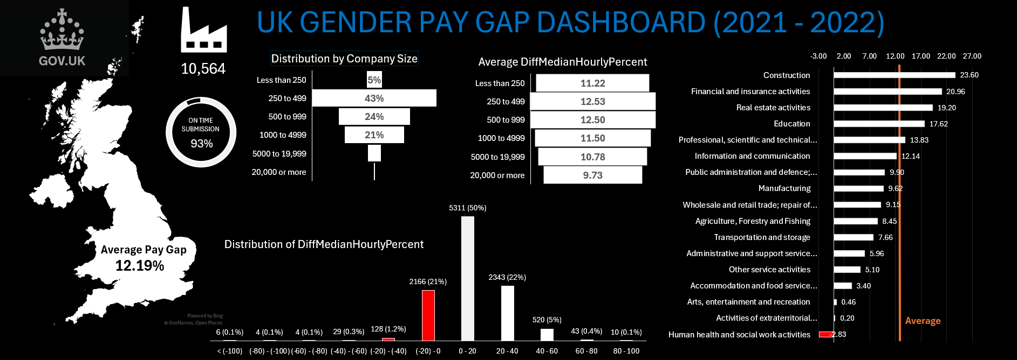
OVERVIEW

Slide 11
DATA ANALYSIS
04

Slide 12
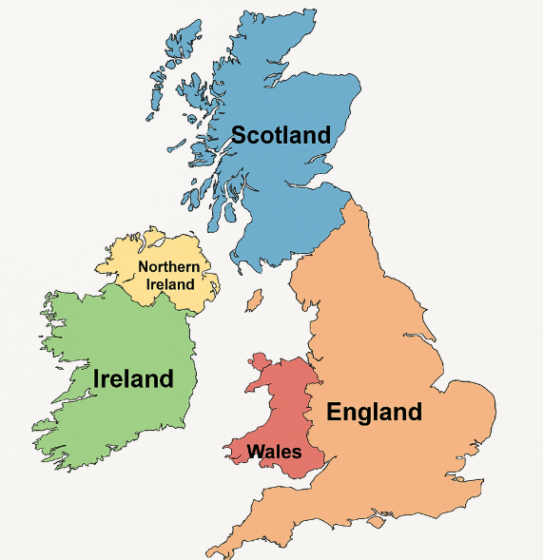
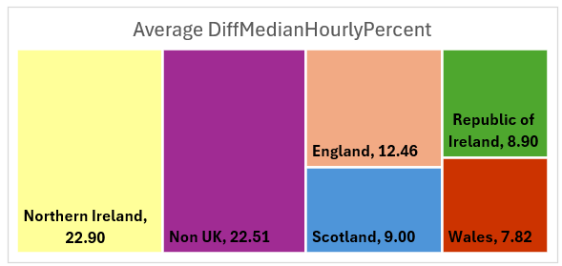
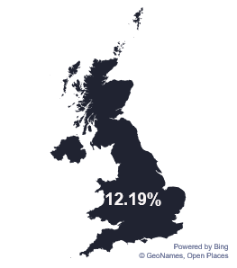
DATA ANALYSIS
Average Pay Gap for Companies across the UK

Slide 13
DATA ANALYSIS
Average Pay Gap for Companies across the UK

Slide 14
DATA ANALYSIS
Differences between the Average Pay Gaps across Industries.
Average

Slide 15
DATA ANALYSIS
Differences between the Average Pay Gaps across Different Regions.
Average

Slide 16
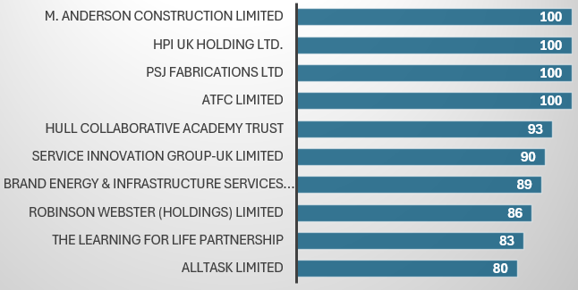

DATA ANALYSIS
Companies with the Largest Pay Gaps.
Top 10 companies who pay men more than women

Slide 17
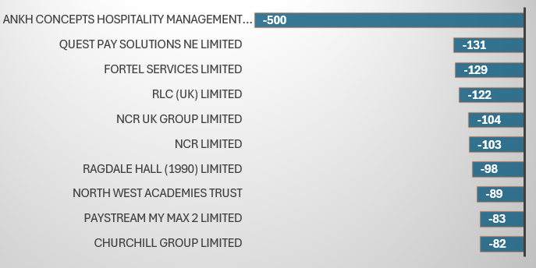
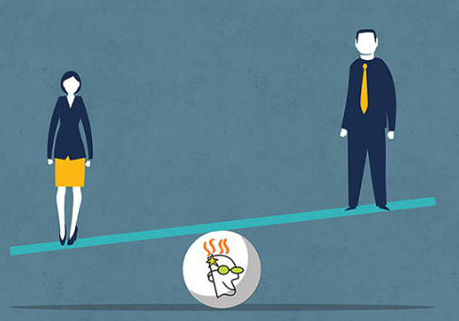
DATA ANALYSIS
Companies with the Largest Pay Gaps.
Top 10 companies who pay women more than men

Slide 18
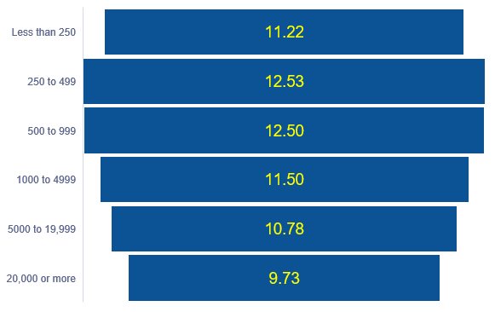
DATA ANALYSIS
Average Pay Gap by Company Size

Slide 19
LIMITATIONS & CAVEATS
05

Slide 20
LIMITATIONS & CAVEATS
Following are the limitations and caveats that should be considered when interpreting the findings:
Gender Pay Gap ≠ Equal Pay
The gender pay gap measures average earnings differences between men and women across all roles, but it does not indicate whether men and women are being paid equally for the same job.
A company could have a gender pay gap due to fewer women in senior roles, even if they have an equal pay policy.
Lack of Industry-Specific Context
Some industries (Construction, Finance, and Technology) have historically fewer women in leadership positions, which inflates the pay gap.
Comparisons across industries should account for structural differences, such as workforce composition and role distribution.
No Adjustments for Part-Time & Flexible Work
The dataset does not account for differences in working hours, such as the fact that women are more likely to work part-time, which affects average pay.
A high gender pay gap may partly reflect work-life balance choices, rather than outright pay discrimination.

Slide 21
LIMITATIONS & CAVEATS
No Consideration of Experience & Qualifications
The dataset does not include information on education, experience, or job tenure, which are key factors in determining pay.
A reported pay gap may not necessarily be due to bias but could be influenced by differences in career progression.
Data Quality & Compliance Issues
Some companies may report incorrect or incomplete data, and smaller firms (with fewer than 250 employees) are not required to report at all.
We need to be cautious when analyzing companies with missing, inconsistent, or outlier data.
No Breakdown by Job Role or Seniority
The dataset does not show pay gaps within specific job roles or levels (e.g., entry-level vs. executive roles).
Large pay gaps might indicate underrepresentation of women in higher-paying roles, rather than direct pay discrimination.

Slide 22
RECOMMENDATION ON
DATA COLLECTION PROCESS
06

Slide 23
RECOMMENDATION ON
DATA COLLECTION PROCESS
Improving data collection through validation, completeness checks will ensure more accurate, reliable, and insightful gender pay gap reporting across the UK.
Standardization
Introduce a standardized format for employer names, addresses, and SIC codes to improve categorization.
Improve Data Completeness
Ensure all companies provide SIC codes to allow for accurate industry analysis. (7% of missing SIC codes)
Ensure that key mandatory fields are provided in the correct format to allow for proper analysis.
Define clearly the roles of the ResponsiblePerson to improve accountability on data accuracy.
Workforce Composition & Role-Based Data
Provide a breakdown by employment type (Full-time vs. Part-time).
Job Role Categories – Breakdown of employees by seniority levels (e.g., entry-level, mid-management, senior leadership)

